Slide 1


Concept Generation & Selection
Team Red Feather: Nathan Fisher, Leann Hernandez, & Trevor Scott

Slide 2
Background: Solar Heater Project
The Navajo Generating Station (coal power plant) closed in November of 2019.
Residents of the local reservation were receiving coal for highly discounted prices prior to the power plant closing.
This coal was being burned to heat local residents’ homes, along with wood.
The price of coal has since increased greatly now that the power plant has closed.
Burning coal in your home poses respiratory health risks.
Other forms of heat (i.e. space heaters) are not practical due to high risk of fires.
Solar heaters are renewable and inexpensive long term.
Leann

Slide 3
Background: Design Considerations
Redesign for cost and manufacturing:
Previous capstone project estimated cost: ~$950
Competitive with commercial options, but still too expensive.
Red Feather wants to be able to manufacture the device themselves (not addressed fully in previous capstone).
Original design of a thermal battery (and thermal charging system)
Solar heaters cannot operate at night.
Ability to store thermal energy allows for free heating of the home overnight.
Thermal battery will not necessarily eliminate use of wood stove overnight.
Leann

Slide 4
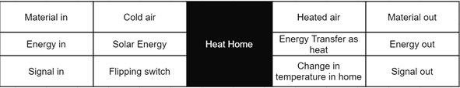
Black Box Model
A black box model below shows the inputs and outputs of various data to heat a home.
Figure 1: Black Box Model
Leann

Slide 5
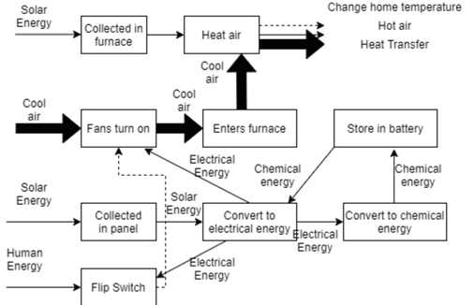
Functional Flow Diagram
A functional flow diagram shows the subfunctions of the device and the different energy flows
Figure 2: Functional Flow Diagram of Solar Furnace, Solar Panel, Fan, and Battery System
Leann

Slide 6
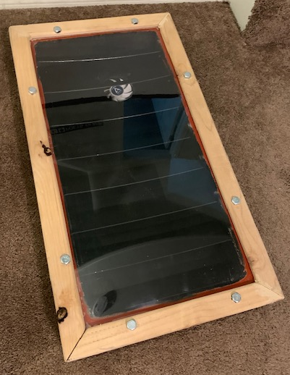
Preliminary Concepts: Redesign
Current Model is too expensive
Plexiglass/polycarbonate/glass
Need something cheaper, shatterproof, and inert
Composite window
Multiple panes glued together
Forced air (fan) vs passive air flow
Cheaper options, bulk buy, etc
Solar panel options
Centralized panel/battery storage/multi-use
Figure 3: Previous Capstone Team’s Solar Heater
Trevor

Slide 7
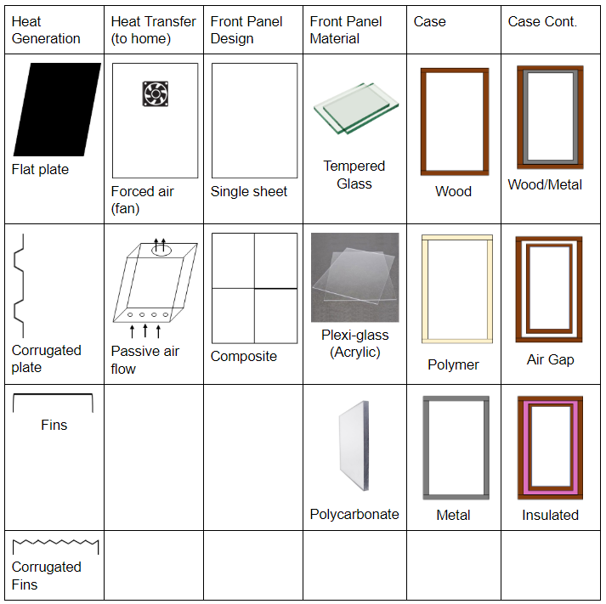
Concept Variants: Morph Matrix (redesign)
Table 1: Morph Matrix
Trevor

Slide 8
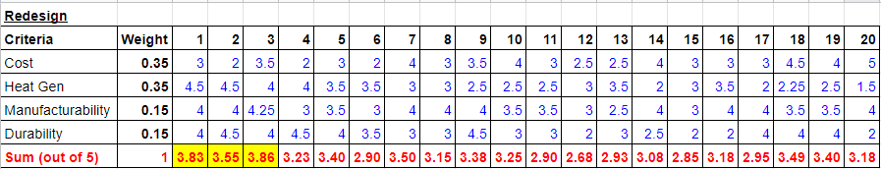
Concept selection: Decision Matrix (redesign)
Table 2: Decision Matrix (redesign)
Trevor

Slide 9
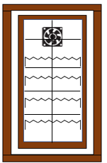
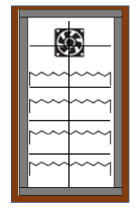
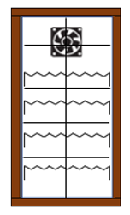
Redesign Top Three
Figure 4: Corrugated Fins + Fan + Composite + Plexi + Air Gap
Figure 5: Corrugated Fins + Fan + Composite + Plexi + Wood/Metal
Figure 6: Corrugated Fins + Fan + Composite + Plexi + Wood
Trevor

Slide 10
Preliminary Concepts: Thermal Battery
Heating Water
Run water through the solar heat to capture some of the generated heat
Don’t severely decrease daytime heating of the house.
Slow flow rate, or water holding system to ensure adequate heat transfer to fluid (i.e. water)
Storing Water
Cheap storage option:
Use something already owned by residents.
Repurpose something such as a cooler.
Insulated in order to hold heat throughout the day.
Heat release system at night
Nathan

Slide 11
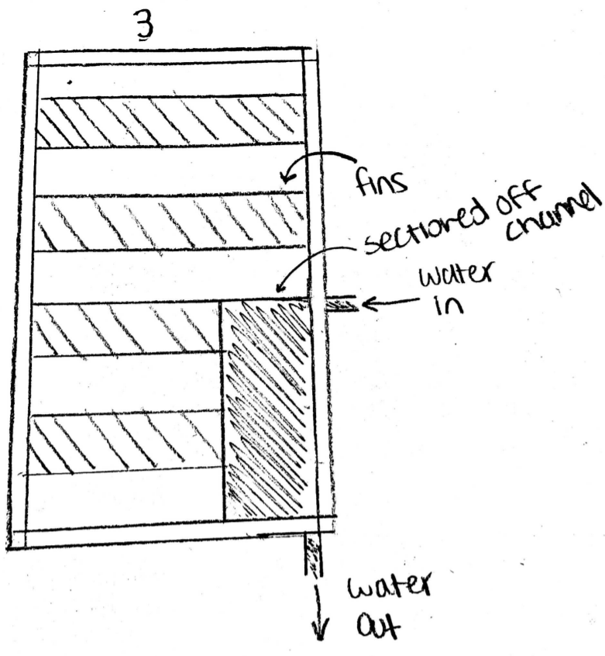
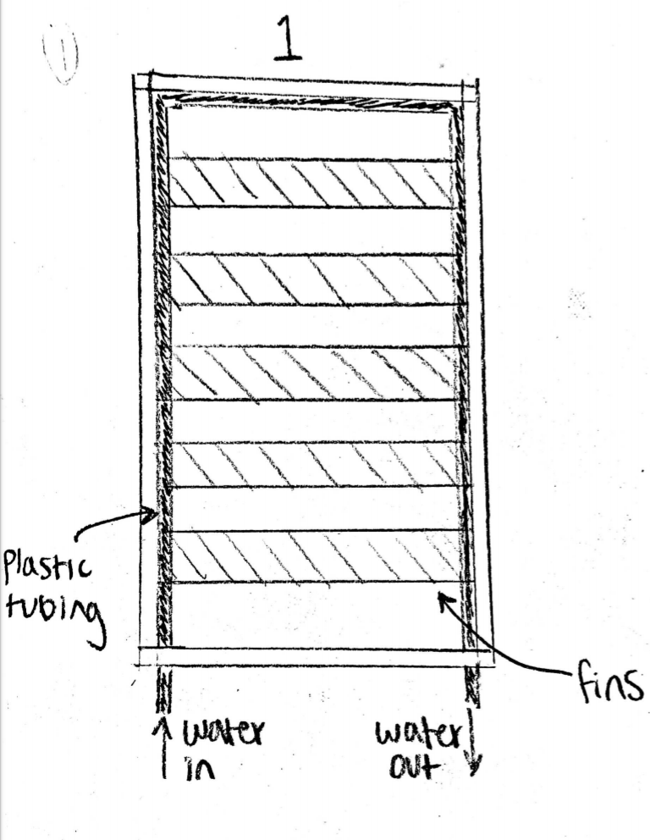
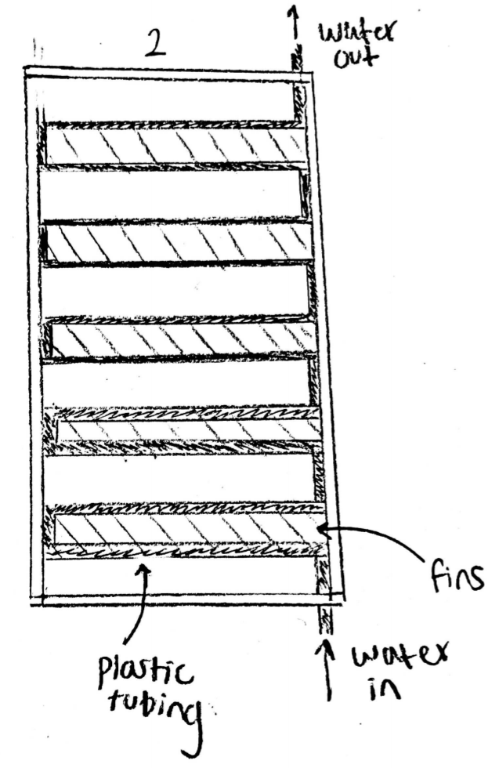
Concept Variants: Thermal Battery (heating)
Figure 7: Thermal Battery Concept 1
Figure 8: Thermal Battery Concept 1
Figure 9: Thermal Battery Concept 1
Nathan

Slide 12
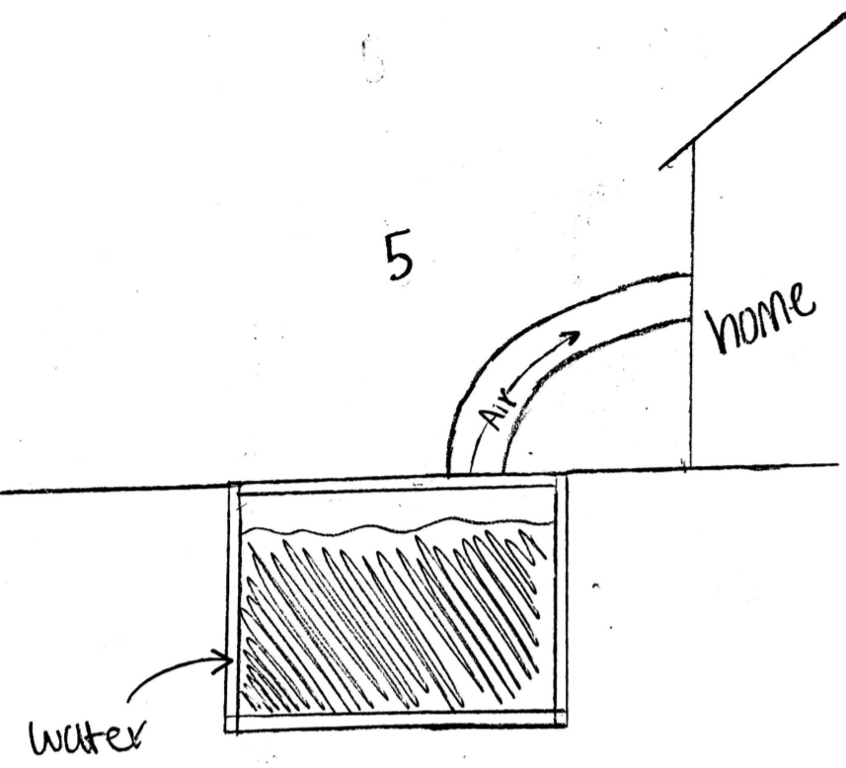
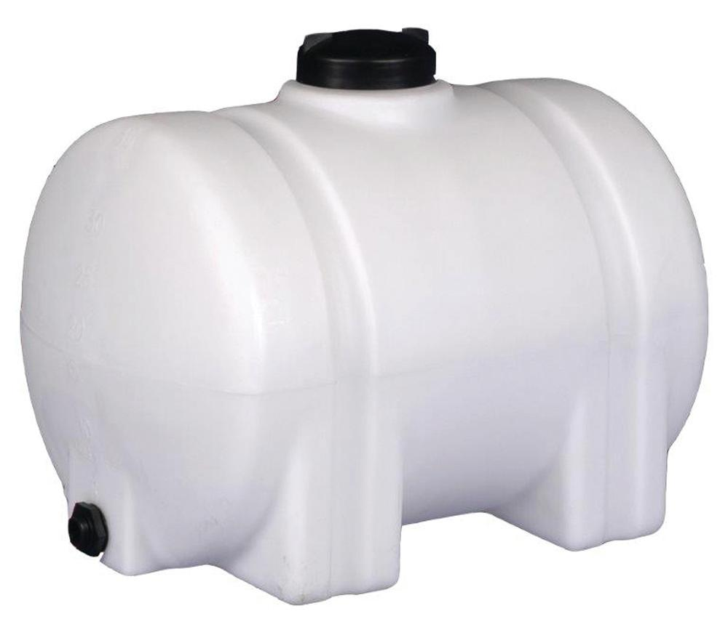
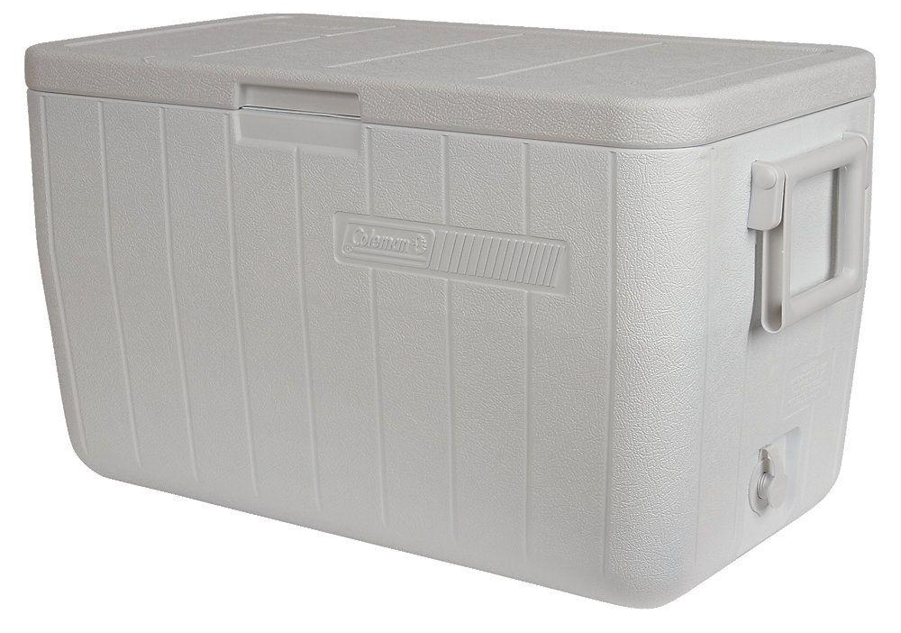
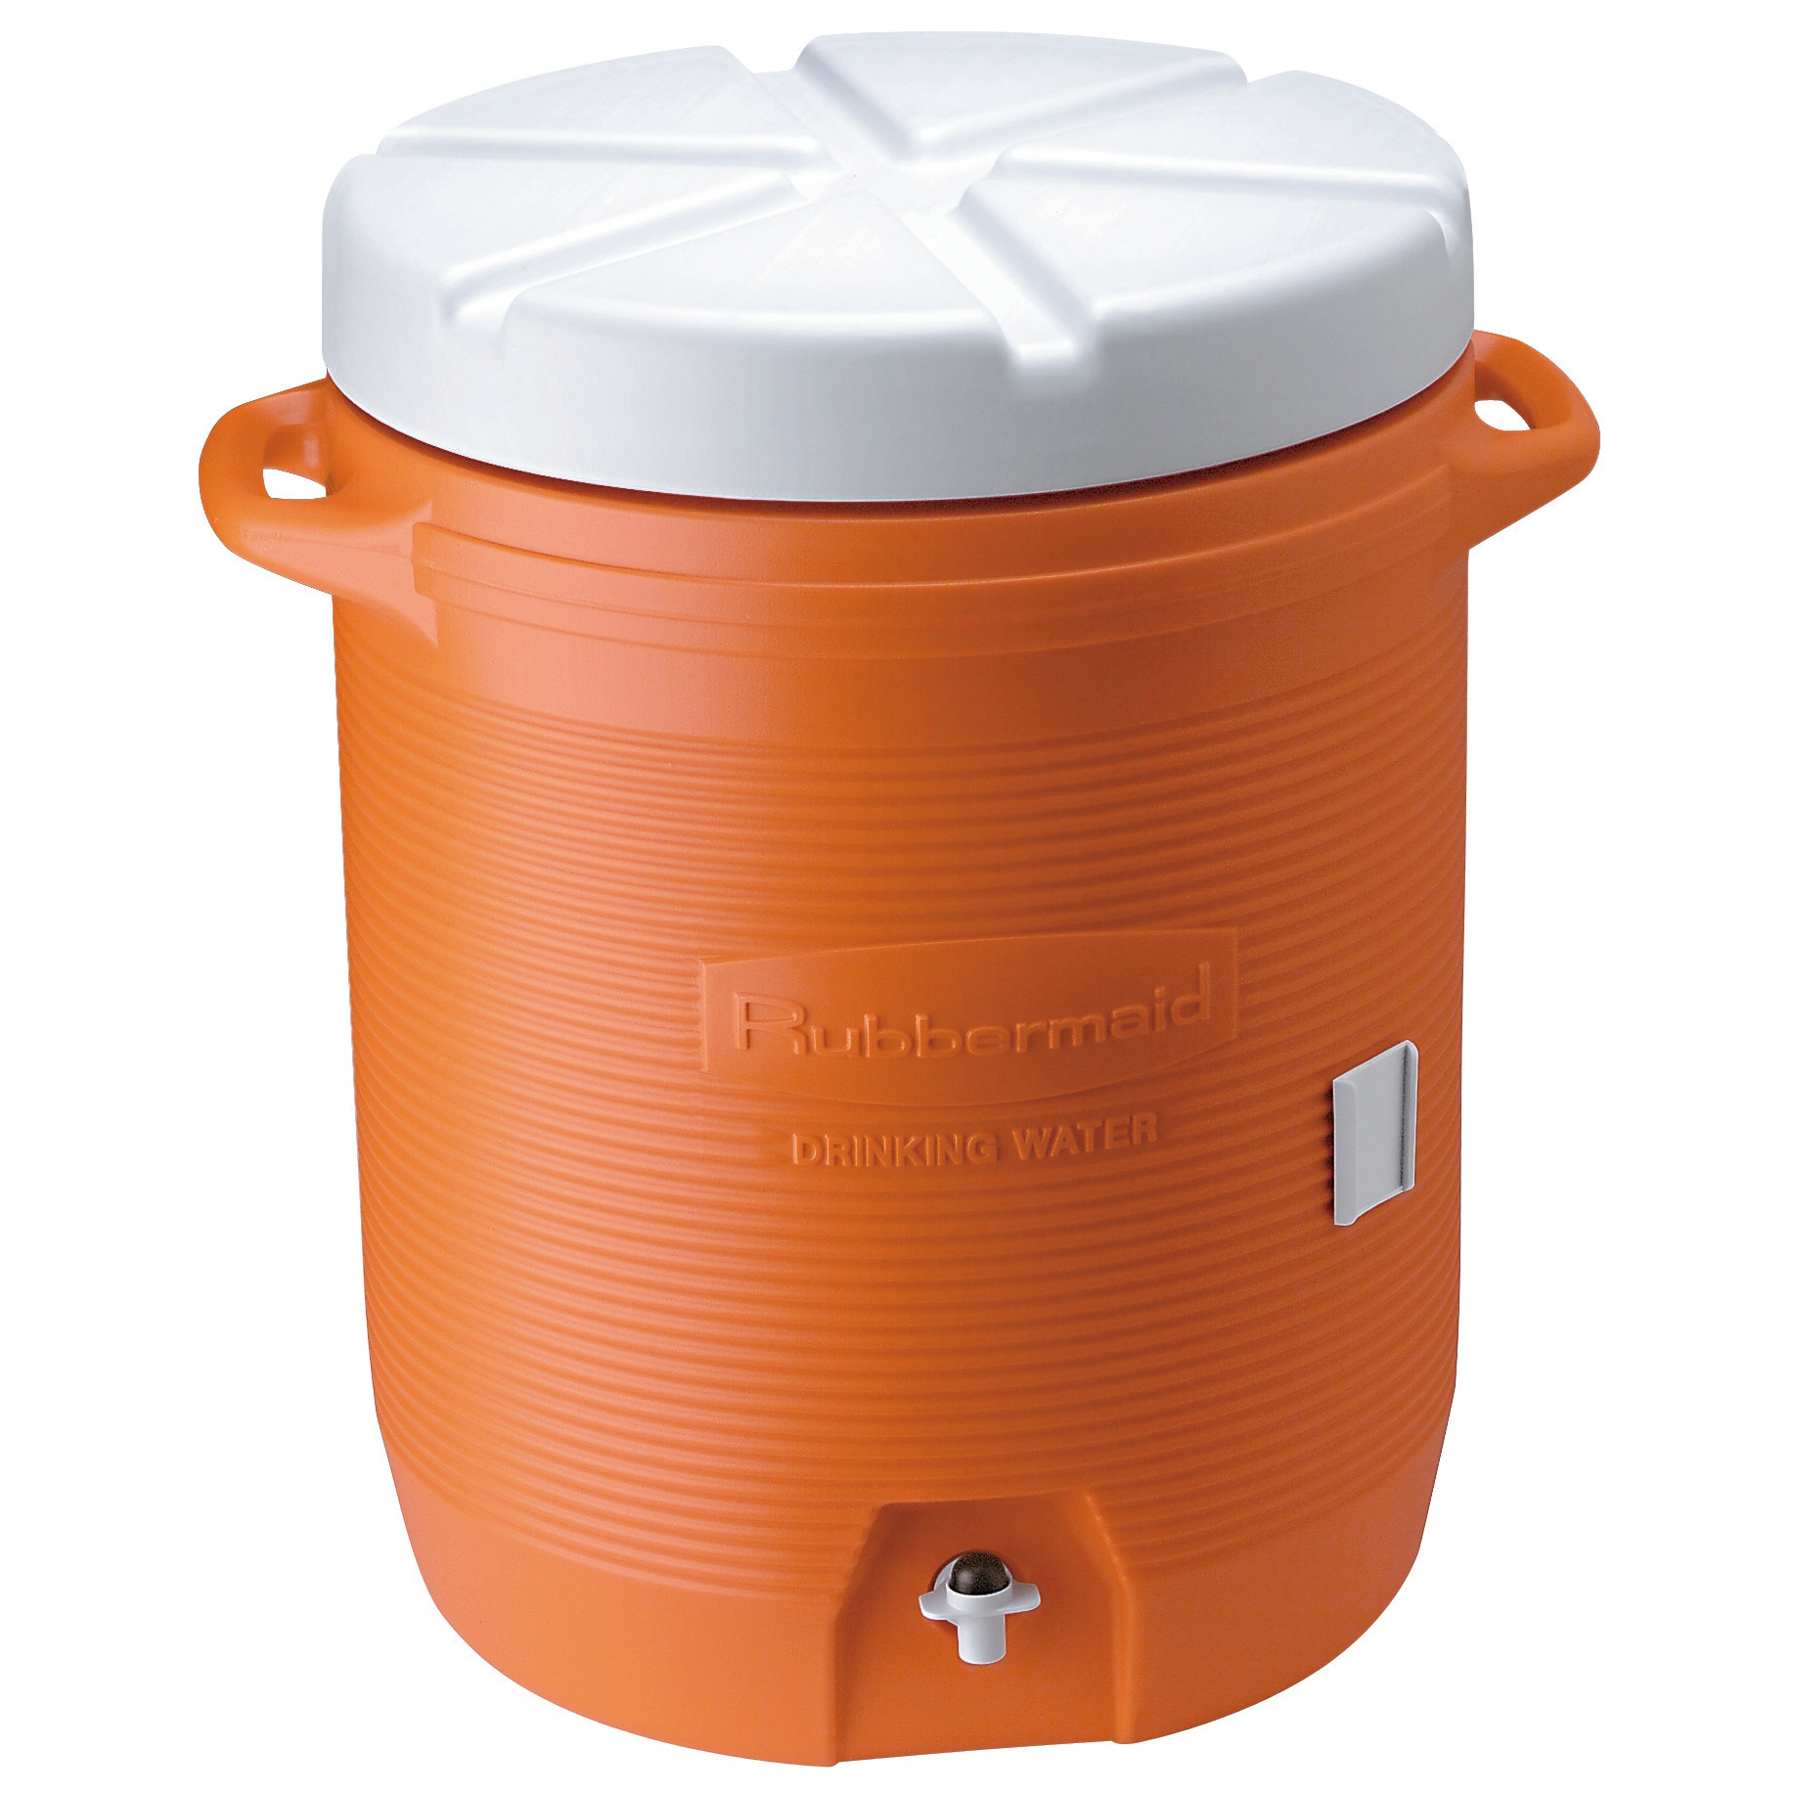
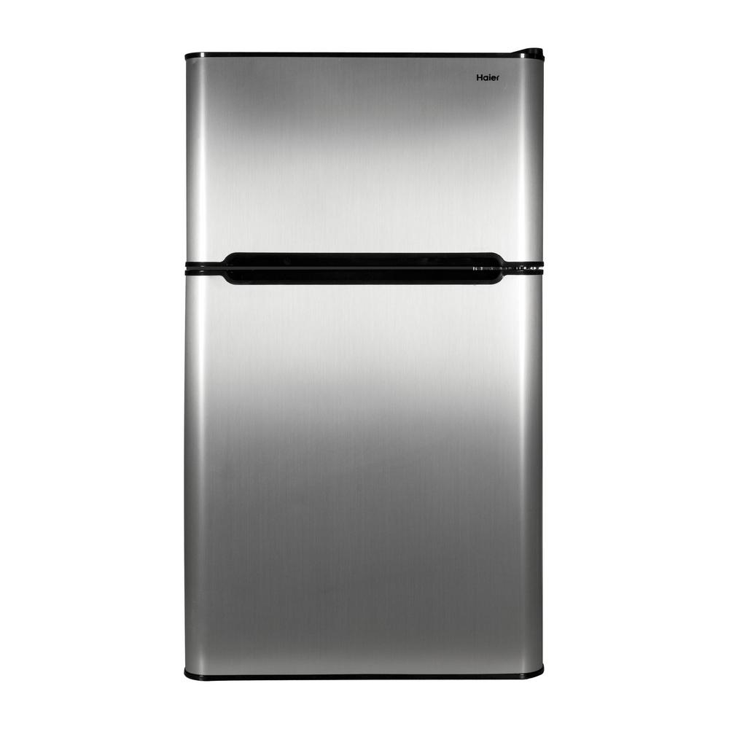
Concept Variants: Thermal Battery (storage)
Figure 10: geothermal storage concept
Figure 11: water tank heat storage concept [1]
Figure 12: marine cooler heat storage concept [2]
Figure 13: water cooler heat storage concept [3]
Figure 14: refrigerator heat storage concept [4]
Nathan

Slide 13
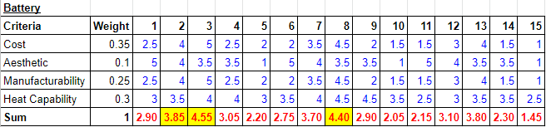
Concept Selection: Decision Matrix (Thermal Battery)
Table 3: Decision Matrix (thermal battery)
Nathan

Slide 14
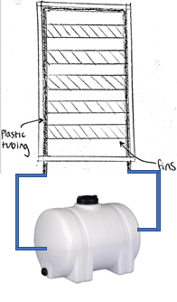
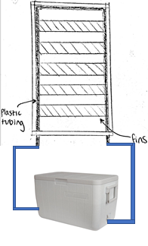
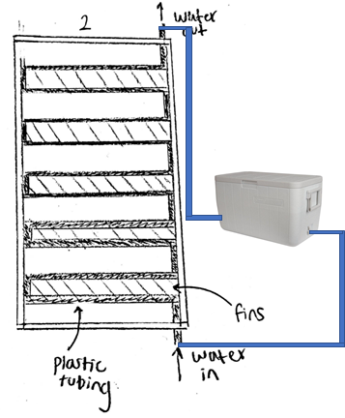
Thermal Battery Top Three
Figure 15: Heating System 1 + Water Tank
Figure 16: Heating System 1 + Marine Cooler
Figure 17: Heating System 2 + Marine Cooler
Nathan

Slide 15
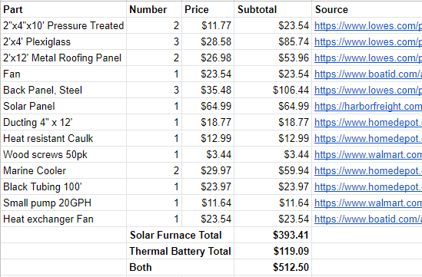
Bill of Materials
Trevor

Slide 16
References
[1] “Norwesco 35 Gal. Horizontal Leg Water Storage Tank-45223,” The Home Depot. [Online].Available: https://www.homedepot.com/p/Norwesco-35-Gal-Horizontal-Leg-Water-Storage-Tank-45223/305023021. [Accessed: 23 Feb 2020].
[2] “Coleman 48 Qt. Performance Marine Cooler-3000003702,” The Home Depot. [Online]. Available: https://www.homedepot.com/p/Coleman-48-Qt-Performance-Marine-Cooler-3000003702/206851499. [Accessed: 23 Feb 2020].
[3] “Rubbermaid FG16100111 10 Gallon Orange Water Cooler,” Walmart.com, 21-Jun-2013. [Online]. Available: https://www.walmart.com/ip/Rubbermaid-FG16100111-10-Gallon-Orange-Water-Cooler /21633485. [Accessed: 23-Feb-2020].
[4] “Haier 3.2 cu. ft. Mini Fridge in Virtual Steel-HC32TW10SV,” The Home Depot. [Online]. Available: https://www.homedepot.com/p/Haier-3-2-cu-ft-Mini-Fridge-in-Virtual-Steel-HC32TW10SV/300858990. [Accessed: 23-Feb-2020].

